Slide 1
Developer Training
Lab 4: Component Library

Slide 2
Introduction

Slide 3
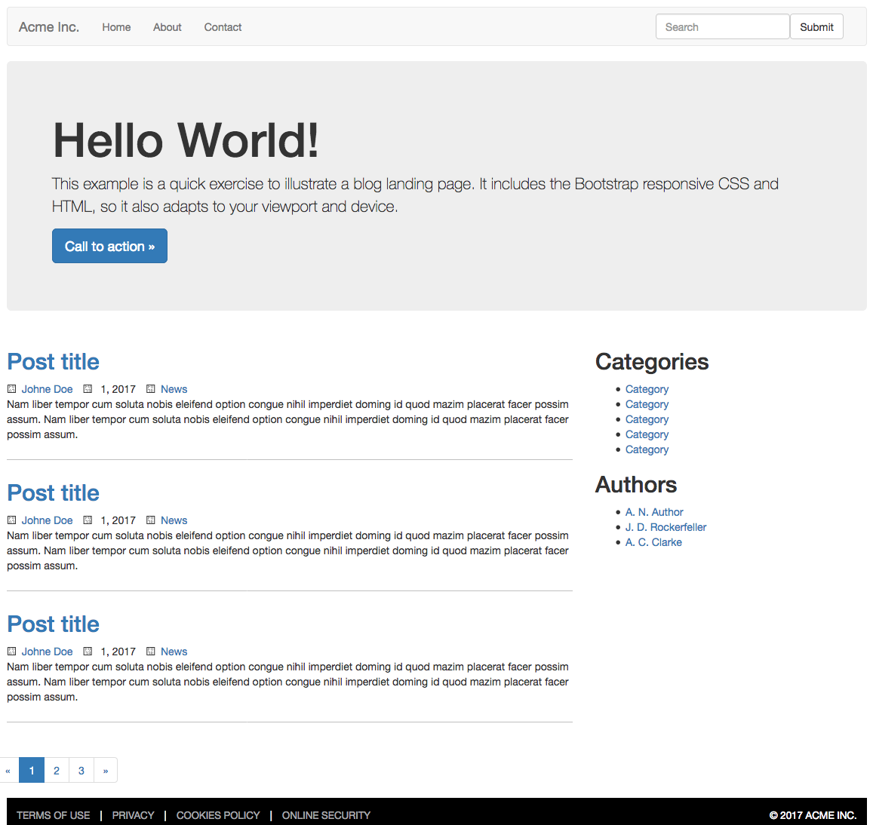
What we’ll be making

Slide 4
What we’ll be making
Link component
Primary Navigation component
Header component
Footer component
Site wrapper
Article component
Article template

Slide 5
Header component

Slide 6
Planning our Header and Footer
Header needs:
  Logo
    Src
  Primary Navigation
    List of…
      Link
        Text
        Href
Footer needs:
  Footer Navigation
    List of…
      Link
        Text
        Href
  Copyright message
    Text

Slide 7
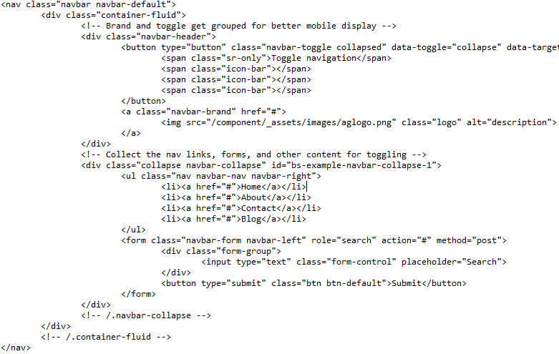
Starting our Header component
First we need our markup
Copy it from the site
Look for component patterns
  Primary Navigation
  Link
  Image

Slide 8
Starting our Header component
Easiest to start lowest
Start with a link
  Contains Href
  And Text
  These are Core components
Isolate the markup for a link
  <a href="home.html">Home</a>
Convert component items into fields
We use moustache syntax
  <a href="{href}">{name}</a>
Now it’s ready to be a component

Slide 9
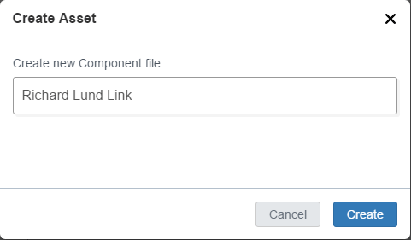
Creating a Link component
In V3, navigate to /Training Sandbox /Component Library /Component Project /Component Library /Component Definitions
Go into your named folder
Choose File > New > Component
  Name it “Your Name Link”
  Names MUST be unique

Slide 10
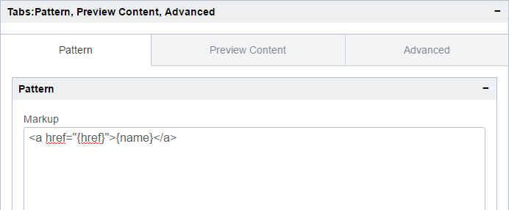
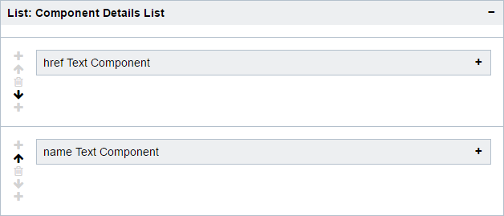
Creating a Link component
Go to the Form view
Type the markup
  <a href="{href}">{name}</a>
Click Save
  Wait for the green box
Click to reload the view
  Scroll to the bottom

Slide 11
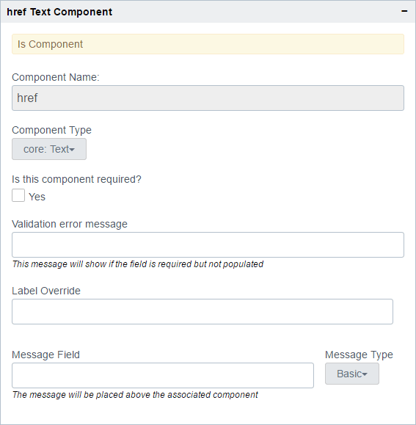
Creating a Link component
Component Library has analysed the markup that we pasted
It found two components
  Expand “href Text Component”
  All are initially core: Text
  Change it to “core: Href”
  Name should be of type Text
  So nothing to do there
Click Save and then to reload

Slide 12
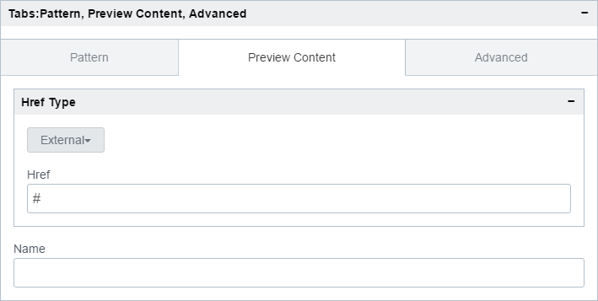
Creating a Link component
Go to the Preview Content tab
This shows a preview of the component input
  Also uses this data for a preview
Try out the Href component
  Choice of Internal/External
  Internal gives an asset picker
  External gives a text box

Slide 13
Creating a Primary Navigation component
The link is ready to be used
Choose File > New > Component
  Name it “Your Name Primary Nav”
Go to the Form view
  Type the following markup
<cp-list> is special markup
  Contents go into a panel
<ul class="nav navbar-nav navbar-right">
<cp-list name="nav_list">
<li>
{item}
</li>
</cp-list>
</ul>

Slide 14
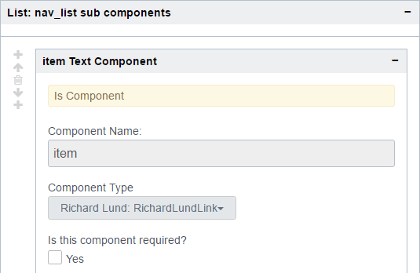
Creating a Primary Navigation component
Save and reload the view
Expand the nav_list List panel
Expand the nav_list sub components
  Change the type to
  Your Name: YourNameLink
  (Spaces are removed from names)
Save and refresh the view

Slide 15
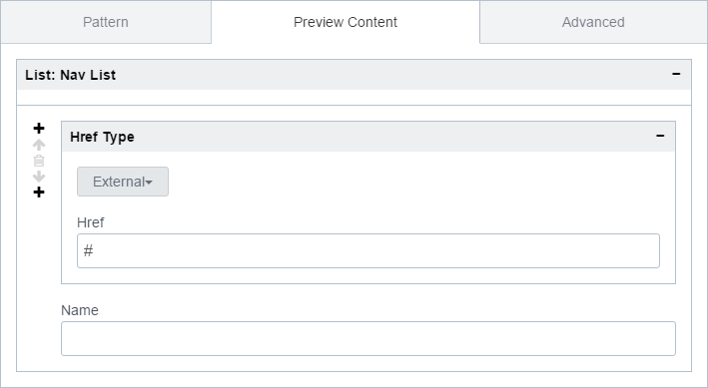
Creating a Primary Navigation component
Go to the Preview Content tab
The link component’s input is shown
And we have controls to add more

Slide 16
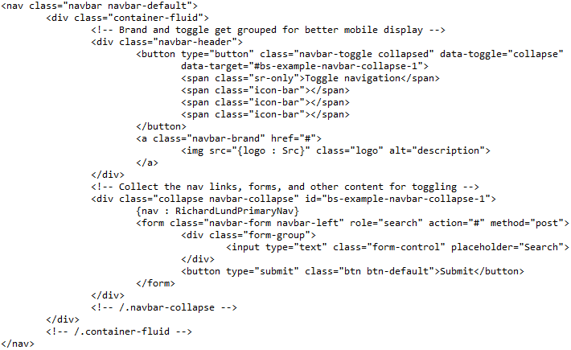
Creating a Header component
The Primary Navigation is ready
Choose File > New > Component
  Name it “Your Name Header”
Go to the Form view
  Add the following markup
The {name : type} syntax is new
  Tells the CL the type we want
  Case sensitive

Slide 17
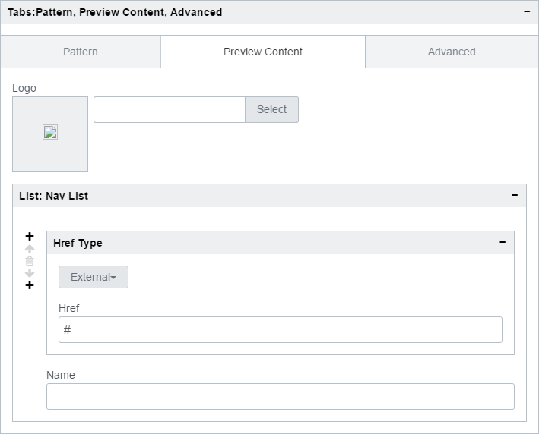
Creating a Header component
Save and reload the view
Go to the Preview Content tab
Working well
  Multiple inputs can get confusing
  Could use some clues for the user
Expand the NamePrimaryNav panel
  Enter “Primary Navigation” in the Message Field

Slide 18
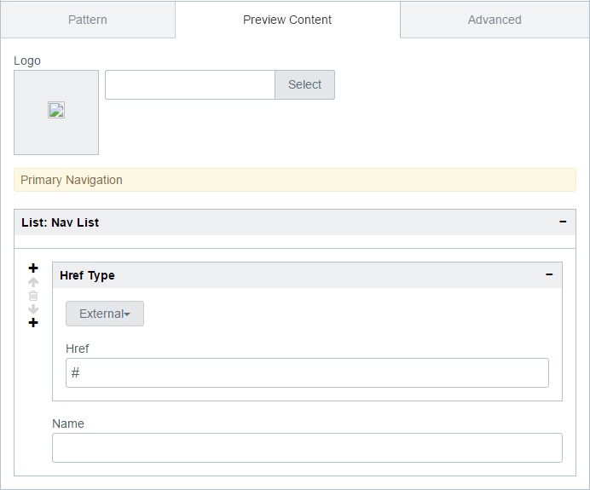
Creating a Header component
Save and reload the view
Go to the Preview Content tab
Now we have some separation
  Add more if you wish

Slide 19
Footer component

Slide 20
Creating a Footer component
Choose File > New > Component
  Name it “Your Name Footer”
Go to Form view
Add the following markup
Save and reload the view
Check the preview
<footer class="footer">
<div class="container">
<div class="row">
<p class="text-muted">{copyright}</p>
</div>
</div>
</footer>

Slide 21
Site Wrapper

Slide 22
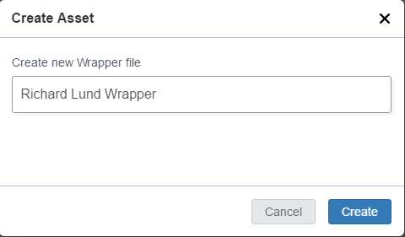
Creating a Site Wrapper
In V3, navigate to /Training Sandbox /Component Library /Component Project /Component Library /Nav Wrapper Definitions
Go into your named folder
Choose File > New > Training Wrapper
  Name it “Your Name Wrapper”
Go to Form view

Slide 23
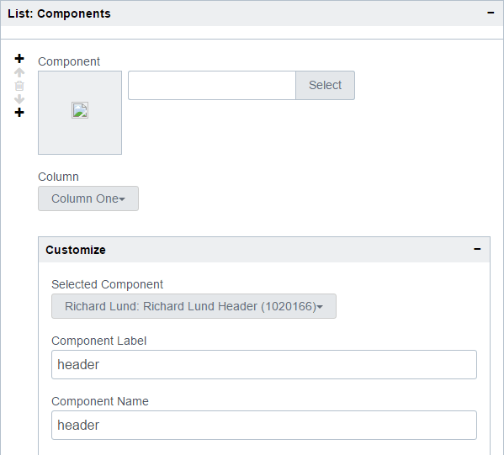
Creating a Site Wrapper
Some defaults are set up for us
In the Header section
  Expand Components
  Expand Customize
  Select your Header component
In the Footer section
  Repeat the above steps
This defined header and footer components for the wrapper

Slide 24
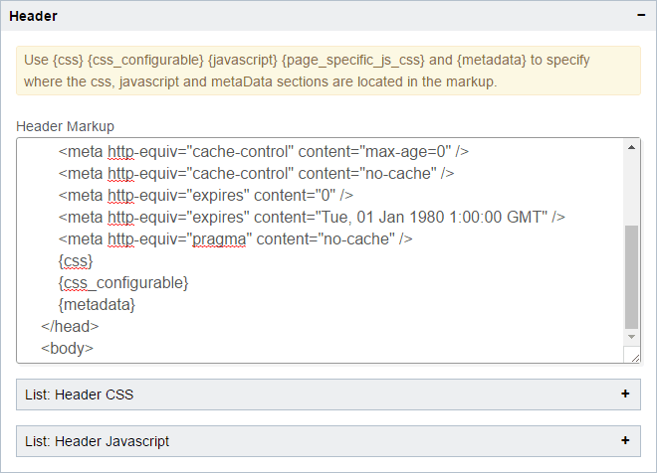
Creating a Site Wrapper
Go to the Wrapper tab
  Expand the Header section
Before </head> add:
  {css}
  {metadata}
  (NB: If they’re not already there)
These allow us to include CSS and page-specific metadata

Slide 25
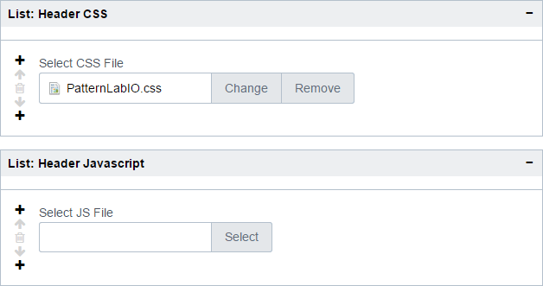
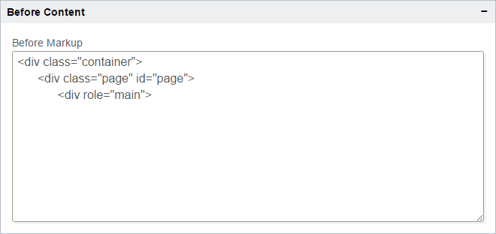
Creating a Site Wrapper
Expand the Header CSS section
  This is where you would add more CSS if you needed it
Similar for the Javascript section
Expand the Before Content section
  This is content before our in-page components get rendered
Similar for the After Content section

Slide 26
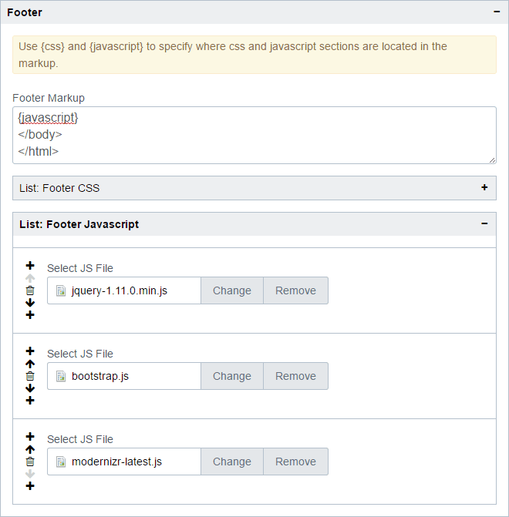
Creating a Site Wrapper
Expand the Footer section
  As with the header we can provide CSS and JavaScript here
Verify that we have:
  jquery-1.11.0.min.js
  bootstrap.js
  modernizr-latest.js

Slide 27
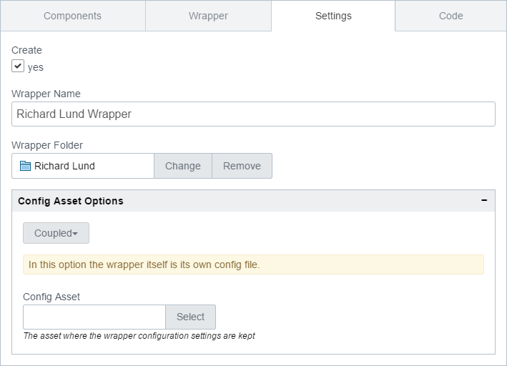
Creating a Site Wrapper
Go to the Settings tab
Check the “Create” box
Enter “Your Name Wrapper” for the Name
Select the Wrapper Folder as
  /Training Sandbox /Component Library /Component Project /Templates /Your Name
Ensure the option is set to Coupled
  Leave the Config Asset empty
Click Save

Slide 28
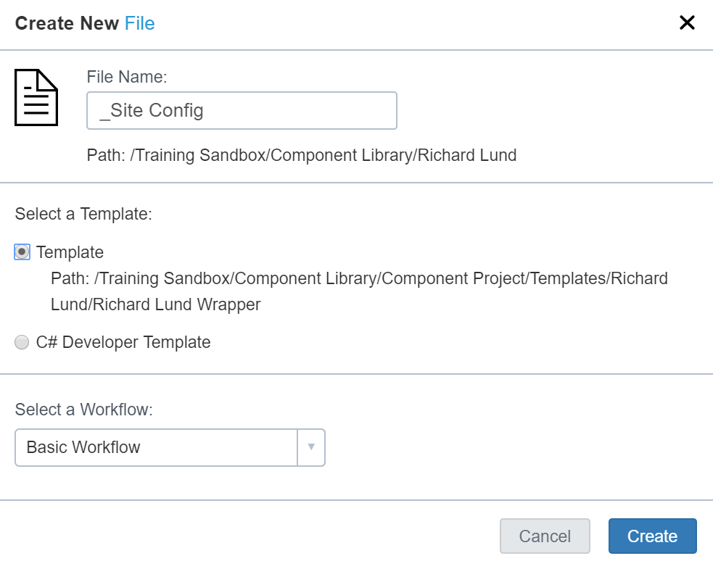
Creating a Site Configuration asset
Navigate to your folder in
  /Training Sandbox /Component Training/Your Name
Choose File > New > File
  Name it “_Site Config”
  Select your Nav Wrap template
    From your named folder
    Inside Templates, NOT Definitions
  Choose the Basic Workflow

Slide 29
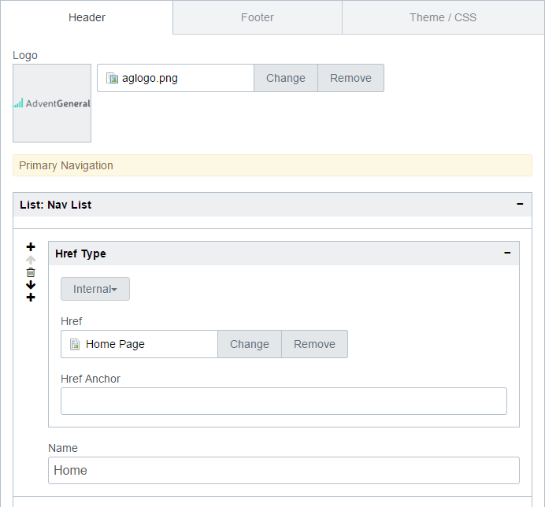
Creating a Site Configuration asset
Go to the Form view of your asset
Select _Assets/images/aglogo.png
Add links for
  Home
  About
  Contact
  Blog
Go to the Footer tab
  Add a suitable copyright message
Save

Slide 30
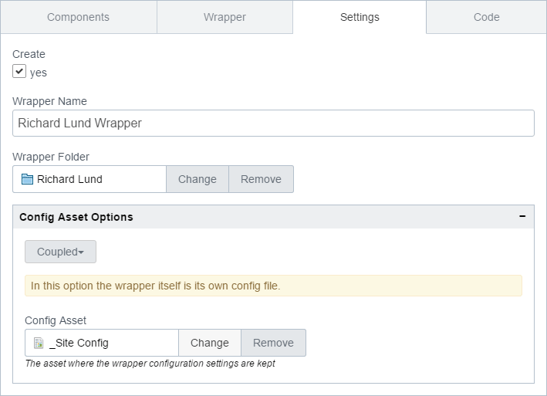
Updating the Site Wrapper
Return to your Wrapper
Go to the Settings tab
Ensure the option is set to Coupled
  Select your new _Site Config asset for the Config Asset field
Click Save

Slide 31
Article Component

Slide 32
Create an Article component
Navigate to your folder inside Component Definitions
Choose File > New > Component
  Name it “Your Name Article”
Add the following markup
Save and reload
Check the preview to see the input
<article class="article">
<header class="article-header">
<h1>{headline : Text}</h1>
<div class="byline">by {author : Text}</div>
</header>
<p class="intro">{intro : Text}</p>
{content : Wysiwyg}
</article>

Slide 33
Article Template

Slide 34
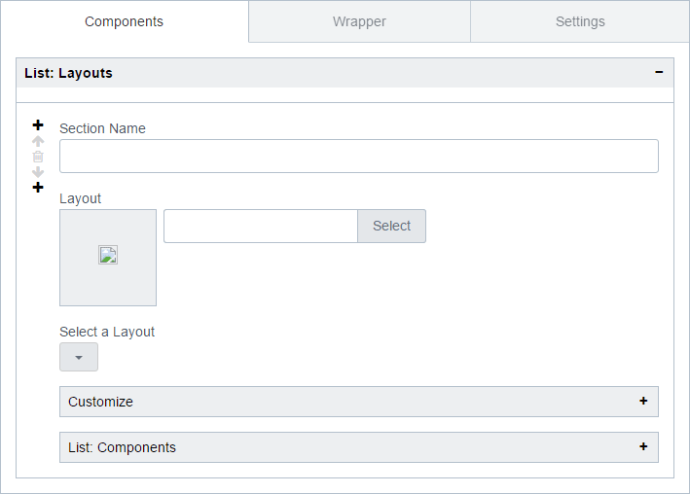
Create an Article template
Navigate to your folder inside Template Definitions
Choose File > New > Template
  “Your Name Article Template”
Go to Form view
Here we define the layout of components on the page

Slide 35
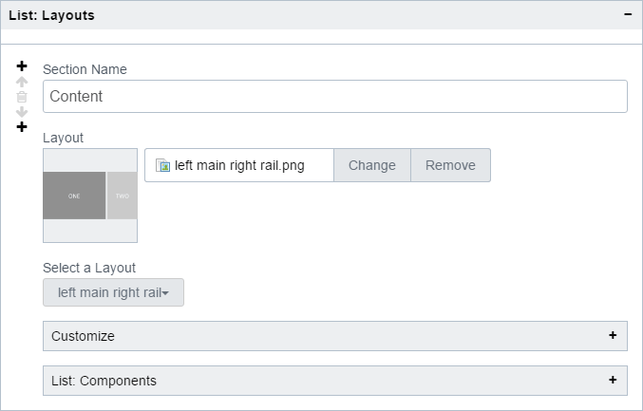
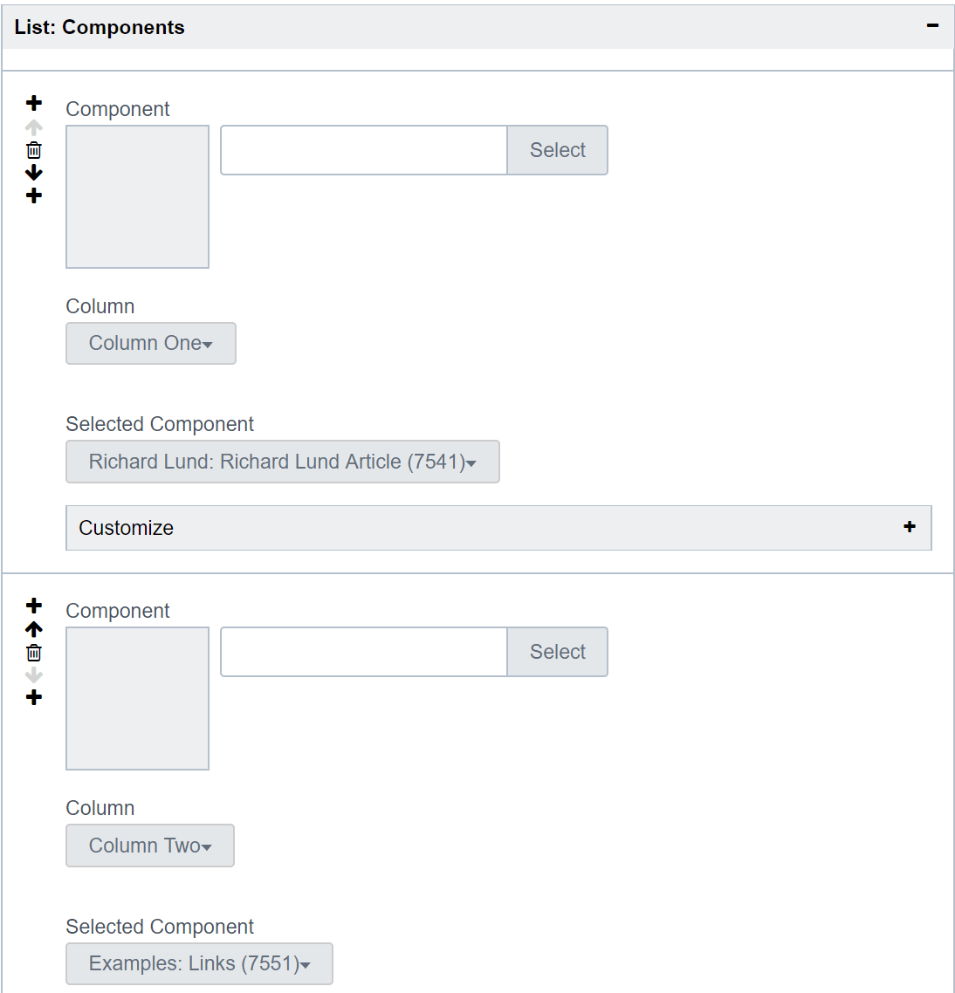
Create an Article template
Section Name = “Content”
Layout = “left main right rail”
  Choose on the Dropdown
  The picture is optional
Expand Components
  Select your article for column one
  Click the + button
  Examples: Links for column two

Slide 36
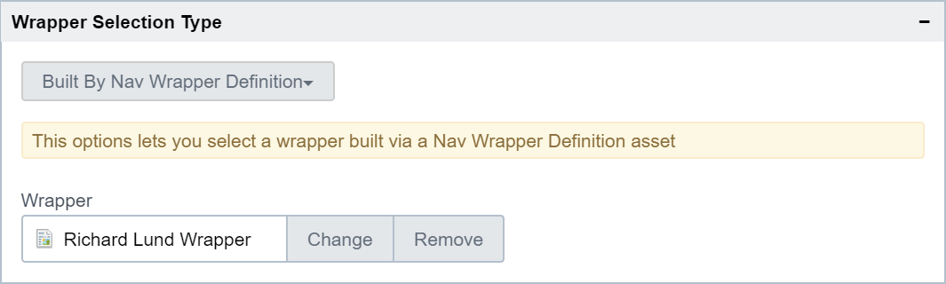
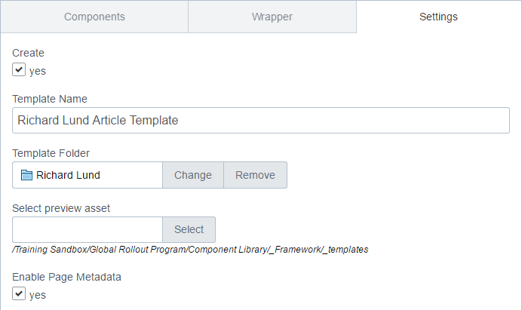
Create an Article template
Go to the Wrapper tab
Verify “Built By Nav Wrapper Definition”
Select your wrapper
Go to the Settings tab
Check the Create box
Select your template folder
Check the “Enable Page Metadata” box
Click Save

Slide 37
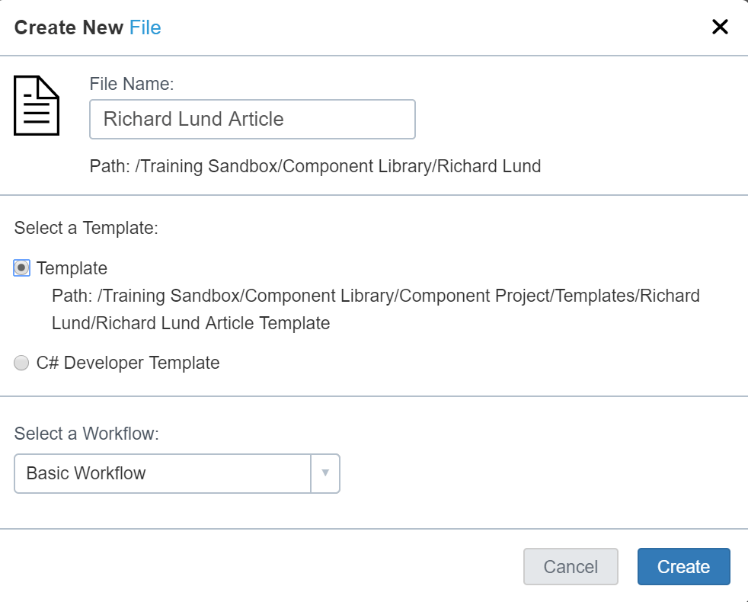
Create an Article asset
Navigate to your content folder
File > New > File
  Name it “Your Name Article”
  Select your Article template
    From Templates, NOT Definitions
  Choose Basic Workflow
Click Create
Go to Form view

Slide 38
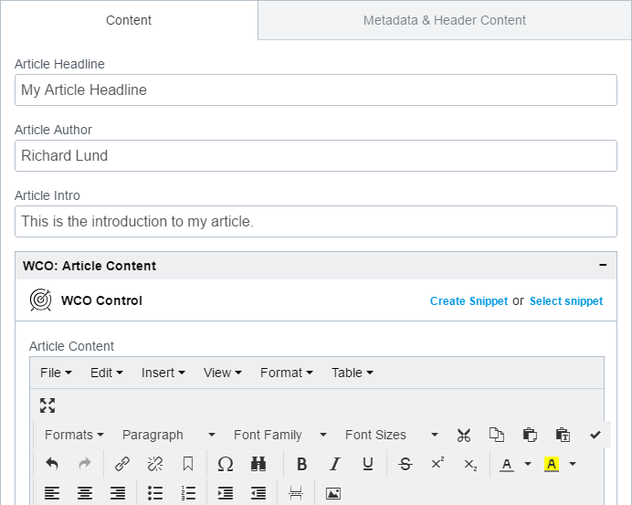
Create an Article asset
Populate your article however you like
Lorum Ipsum is good if you’re short on inspiration
Add a few links to the list at the bottom
Save

Slide 39
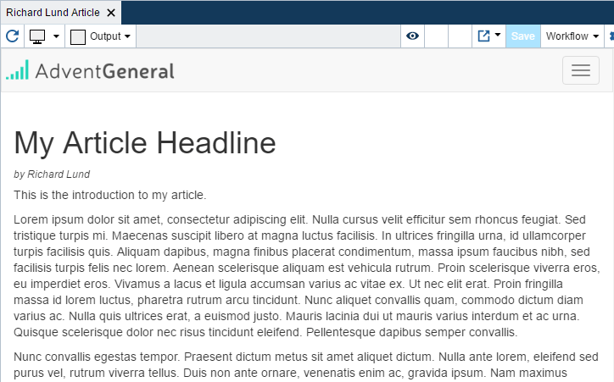
Create an Article asset
Finally…
Preview!
Our work here is done

Slide 40
Thank You!

